Slide 1
原子核行列要素の方法による不一致問題の解決をめざして
(A02公募研究）
メンバー
岩田順敬 （東大）
日野原伸生 （筑波大）
寺崎順 （筑波大、登壇者）
Nuclear matrix element (NME) of neutrinoless double-β decay
What have been done
What we are going to do
May 16, 2015, Kobe

Slide 2
1. Nuclear matrix element (NME) of neutrinoless double-β decay
Principle to determine effective neutrino mass
$$\left\langle m_{ν}\right\rangle =\left|\sum_{i=1,2,3}{U_{ei}^{2}m_{i}}\right|$$
$$1/T_{0ν}(0^{+}→0^{+})={\left|M^{\left(0ν\right)}\right|}^{2}G_{01}{\left(\frac{\left\langle m_{ν}\right\rangle }{m_{e}}\right)}^{2}$$
Half-life
Nuclear matrix element
Effective 𝜈 mass
Phase-space factor
Experimental measurement
Theoretical calculation

Slide 3
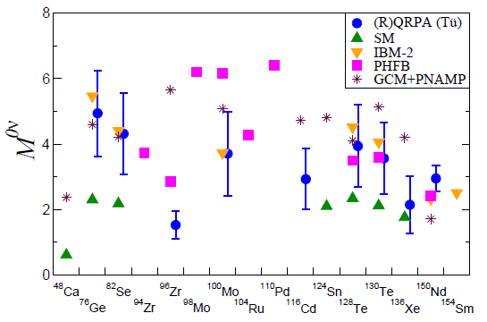
Discrepancy problem of 0vββ NME by methods
A. Feassler, Jour. Phys.: Conf. Ser. 337, 012065 (2012)

Slide 4
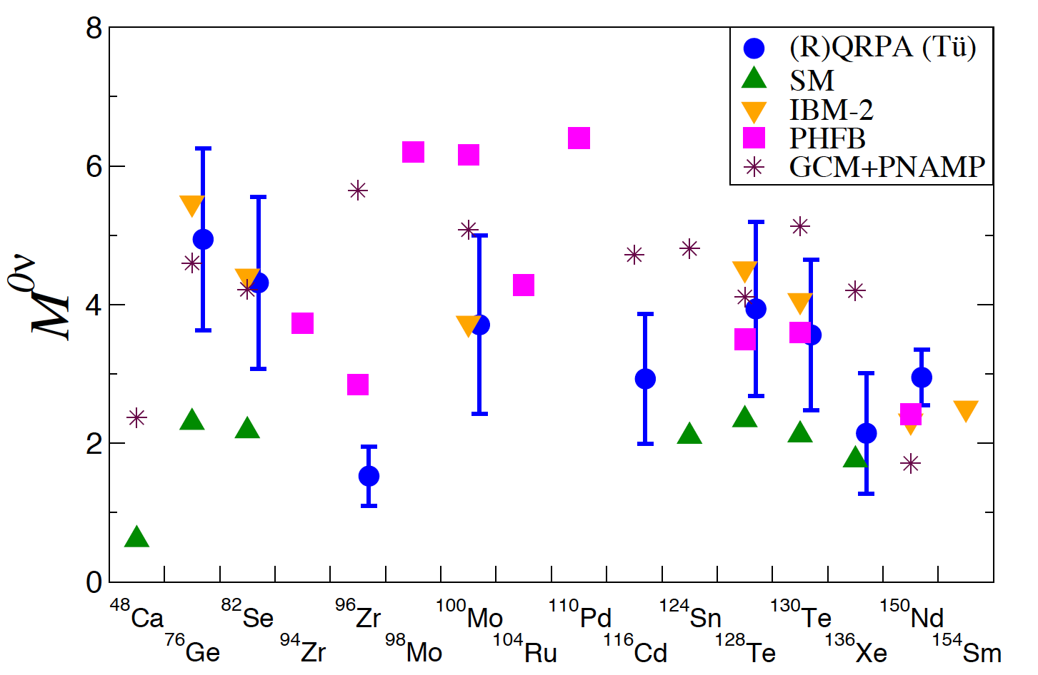
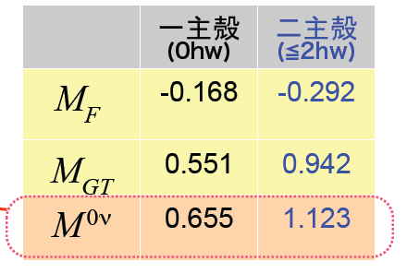
2. What have been done
大規模殻模型計算によるニュートリノレス二重β崩壊の核行列要素
東京大学原子核科学研究センター理論グループ （岩田順敬 特任助教ら）
… …
… …
pf-shell
隣接するsd-shellも考慮する(10¹⁰次元対角化）
ことでこれまで取り込むことができなかった
より低い状態からの励起による効果を取り込む
sd-shell
種々の理論による核行列要素の計算値
計算結果（投稿準備中）
既存の計算(pf殻)と大規模計算（pf殻＋sd殻）との比較
(g_{A}=1.27)
This work
Faessler, Jour. Phys.: Conf. Ser. 337, 012065 (2012)
異なる殻をまたいだ励起の効果で、核行列要素の計算値が7０％ほど増加。
⇨ 半減期の予言値を“ 0.34倍”する効果がある。

Slide 5
2. What have been done
The quasiparticle random-phase approximation (QRPA) approach by Terasaki
My result
Phys. Rev. C 91, 034318 (2015)
A. Feassler, Jour. Phys.: Conf. Ser. 337, 012065 (2012)

Slide 6
3. What we are going to do
Investigation of wave functions for clarifying the origin of the difference in the NME depending on three methods:
Shell model (SM, Iwata)
Generator coordinate method (GCM, Hinohara)
(Q)RPA (Terasaki)
Currently, we have two ideas about how to do this investigation.

Slide 7
Investigation of origin of difference 1
$$M^{(0ν)}≅\sum_{μν,κλ}{\left(\begin{matrix}\begin{matrix} & \\ & \end{matrix} & \\ & \begin{matrix} & \\ & \end{matrix}\end{matrix}\right) \left(\begin{matrix}\begin{matrix} & \\ & \end{matrix} & \\ & \begin{matrix} & \\ & \end{matrix}\end{matrix}\right)}$$
Matrix of the two-body transition operator inducing the 0𝜈𝛽𝛽 decay
Another matrix
$$μν,κλ$$
$$κλ,μν$$
Step 1
Investigate the distributions of the components of $M^{(0ν)}$ and compare them between the different methods.
Step 2
Compare the amplitudes of components of the nuclear wave functions relevant to those important matrix elements between the different methods.
⇨ Origin of the difference in the NME between the different methods will be clarified in terms of the wave functions .

Slide 8
Investigation of origin of difference 1
Step 3
Make that comparison in the following two cases:
SM, GCM and (Q)RPA calculations with their favorite interaction and single-particle space.
Three calculations with unified interaction and single-particle space.
⇨ For example, if comparison 2 shows no difference but comparison 1 does, then the origin of the difference is the interaction and/or single-particle space.
The first sample will be ⁴⁸Ca → ⁴⁸Ti.

Slide 9
Investigation of origin of difference 2
Prepare
$|0_{HF}^{+}〉$ : Hartree-Fock (HF) ground state, solution of the HF eq.
p
h
RPA ground state $\sim \exp{[c_{p}^{†}c_{h}c_{p^{′}}^{†}c_{h^{′}}]}|0_{HF}^{+}〉$
$=|0_{HF}^{+}〉+c_{p}^{†}c_{h}c_{p^{′}}^{†}c_{h^{′}}|0_{HF}^{+}〉+⋯,$
SM ground state $\sim |0_{HF}^{+}〉+c_{p}^{†}c_{h}|0_{HF}^{+}〉+c_{p}^{†}c_{h}c_{p^{′}}^{†}c_{h^{′}}|0_{HF}^{+}〉+⋯$
Investigate the role of this component to the NME.

Slide 10
Note, SM
Consider perturbation by a two-body interaction.
The first-order components of wave function:
p
h
One of the second-order components of wave function:
p
p
$$=$$
$$= c_{p}^{†}c_{h}|0_{HF}^{+}〉$$
h
h

Slide 11
Status
Iwata has already obtained the NME for ⁴⁸Ca → ⁴⁸Ti.
Hinohara is performing test calculations for Ca and Ti with smaller model space.
Terasaki has started the HF(B) calculation of ⁴⁸Ca and ⁴⁸Ti.
Computational resource
Iwata, FY2015
More than 1.35M core hours in total in K computer (RIKEN), HA-PACS (Univ. of Tsukuba) and Vesta (Argonne Nat’l Lab.)
Hinohara, FY2015
0.82M core hours in Coma (Univ. of Tsukuba).
Terasaki, FY2015
Grant-in-aid ⇨ ≅2.5M core hours in Oakleaf-FX (Univ. of Tokyo)

Slide 12
4. Summary
The ultimate goal is to determine the effective $ν$ mass.
Reliable NMEs are necessary.
The discrepancy problem of NME has to be solved.
Clarify the origin of the problem.
The discrepancy problem of NME was introduced.
The results of the NME calculations that the members have ever obtained were shown.
The ideas for clarifying the origin of the discrepancy problem of NME were discussed.
Our status was shown.

