Slide 1
地上における極低バックグラウンド測定の可能性
嶋 達志
大阪大学核物理研究センター
新学術領域「宇宙の歴史をひもとく地下素粒子原子核研究」 2015年領域研究会
2015年5月15日-17日 神戸大学百年記念館 六甲ホール

Slide 2
Contents
Why do we need low-BG on the Earth’s surface?
What is the origin of BG on the Earth’s surface?
How low can BG on the Earth’s surface be?
Summary

Slide 3
1. Why we need low-BG on the Earth’s surface?
Example. ¹²C(α,γ)¹⁶O
¹²C(α,γ)¹⁶O reaction rate at kT ~300keV governs
stellar evolution and ¹²C/¹⁶O ratio after He-burning.
Nucleosynthesis via α- and s-processes
Mass threshold of Type-II SN
Astrophysical S-factor at E_{cm} = 300 keV (Buchmann 1996)

Slide 4
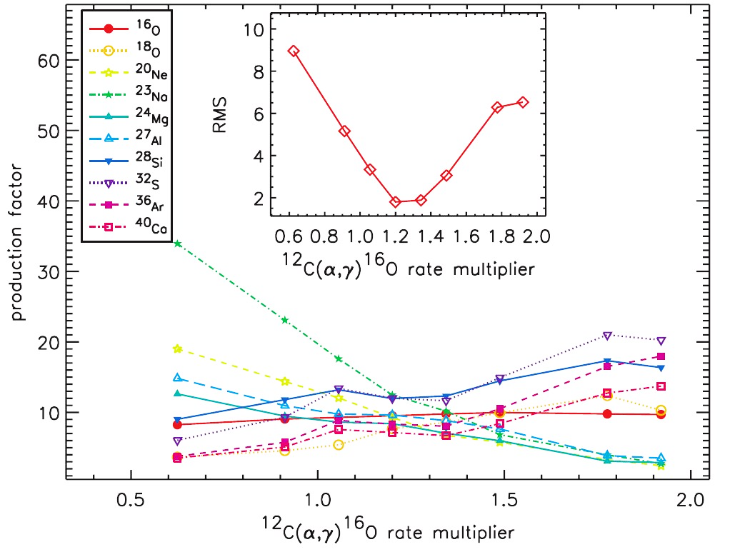
Nucleosynthetic yields vs ¹²C(α,γ)¹⁶O rate
Tur, Heger, Austin, ApJ671, 821 (2007)
σ~25%
(Multiplier to Buchmann 1996)

Slide 5
EUROGAM
M. Assunção et al., Phys. Rev. C73, 055801 (2006)

Slide 6
Status of ¹²C(α,γ)¹⁶O Cross Section Data
σ ~ 10⁻¹¹ b @700keV
~ 10⁻¹⁷ b @300keV (Gamow window;T₉=0.2)

Slide 7
Statistics (example)
¹²C beam 100 μA on He-gas target (10 mm thick, 0.01 atm)
E_{c.m.}= 700 keV, σ= 1 pb
Detection efficiency for γ-rays; ε = 0.01
= 1.5 [count/d] ; stat. error ~14%
for 100day meas. with S/N~1
10 [count/d] for ¹³⁶Xe 2νββ@KamLAND-Zen
A. Gando et al., PRL110, 062502 (2013)

Slide 8
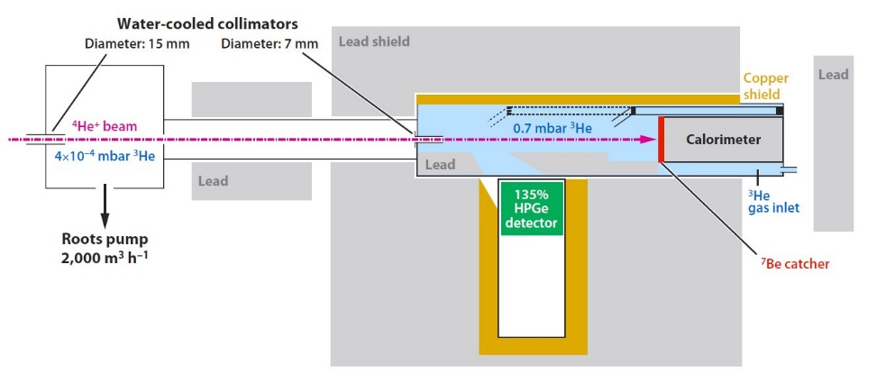
Nuclear astrophysics experiments in underground
LUNA
Cockcroft-Walton, 400keV, p 500μA, α 250μA
135% HPGe with passive shield
Gran Sasso; 3800 m w.e. underground
--- Φ_{μ} ~10⁻⁶×Φ_{μ} on ground
T. Szȕcs et al., EPJ A44, 513 (2010)

Slide 9
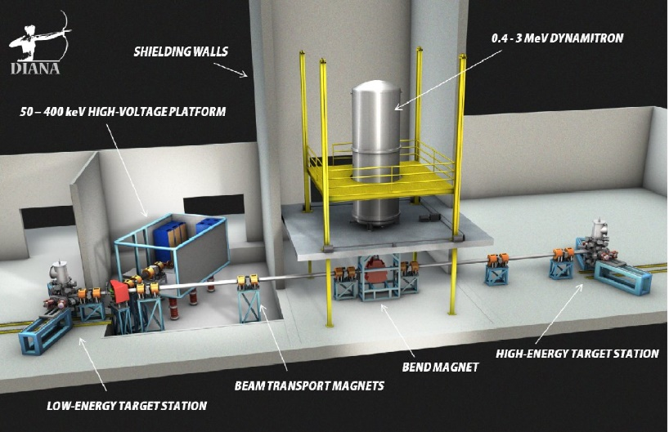
DIANA
Two accelerators;
Cockcroft-Walton < 400 keV, < 100 mA
Dynamitron < 3MeV, < 5 mA
DUSEL (Homestake); 3800 m w.e. underground
--- Φ_{μ} ~10⁻⁶×Φ_{μ} on ground

Slide 10


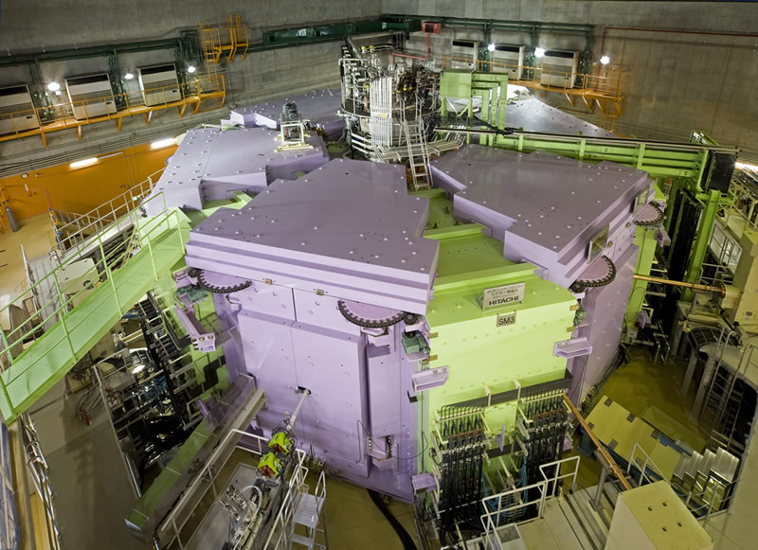
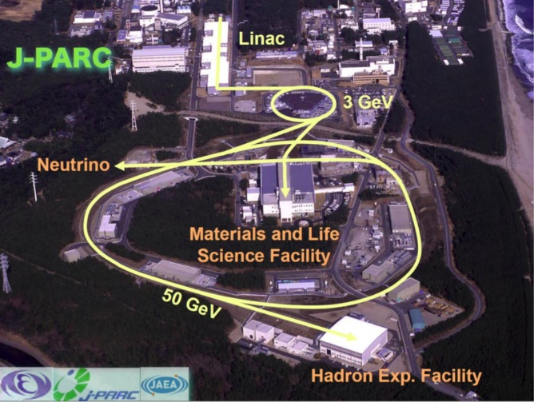
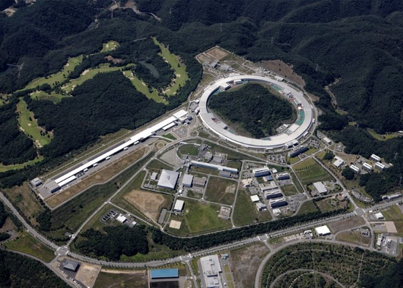
Underground accelerator is the
“standard tactics” of low-background
experiments on nuclear and particle
physics.
Hmm… “standard” is the “standard”.
But…

Slide 11
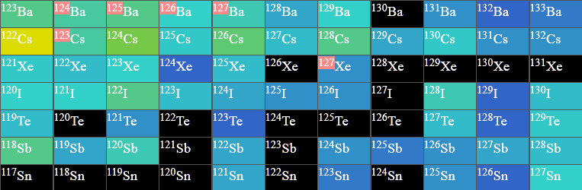
Neutron capture on unstable nuclei
¹²⁵Sb(n,γ)¹²⁶Sb @30keV
σ=0.3b (ENDF/B-VI)
0.6b (JENDL-4.0)

Slide 12
¹²⁵Sb T_{1/2} =2.76y
σ(30keV)= 0.3b (ENDF/B-VI), 0.6b (JENDL-4.0)
Accumulate 10⁸ /s ¹²⁵Sb for 7days ⇒ ~6×10¹³ of ¹²⁵Sb
⇒ ¹²⁶Sb production rate ~0.02 /s (Φ_{n} =10⁹ n/cm²/s)
⇔ ¹²⁵Sb decay rate ~5×10⁵ /s
¹²⁵Sb β⁻ Q_{β}=621.9keV
γ 427.9keV 463.4keV 600.6keV 635.95keV (single)
¹²⁶Sb β⁻ Q_{β}=1920keV
γ 414.7keV 666.5keV 695.0keV (cascade, BR=83.3%)
Triple γ-ray coincidence with multi-detector

Slide 13
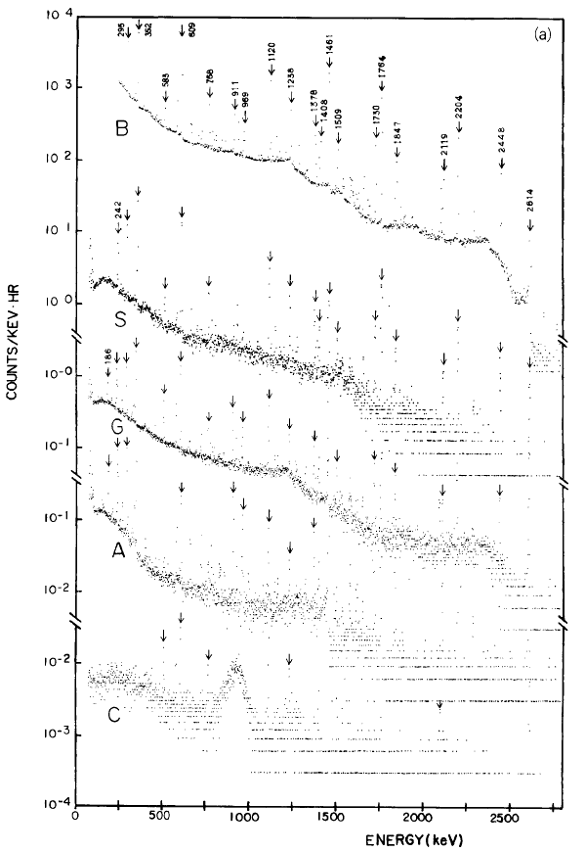
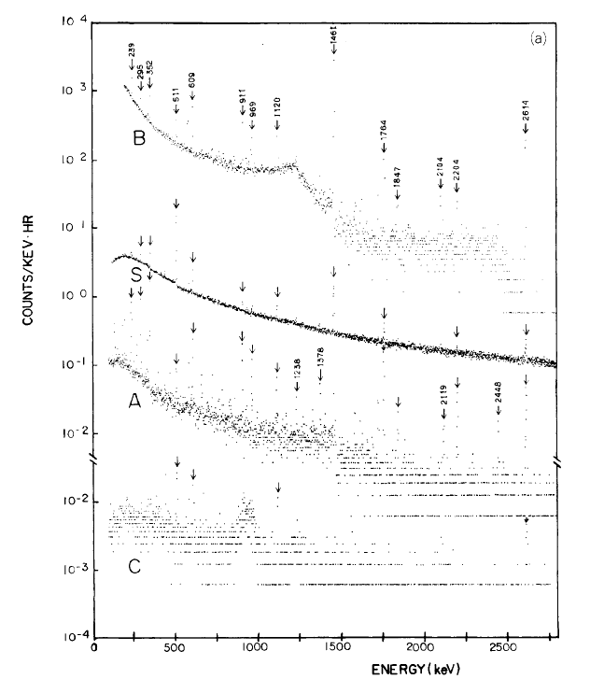
2. What is the origin of BG on the Earth’s surface?
Osaka
(sea level, w/o Rn rejection)
Kamioka
(1000m underground, 2700m w.e.）
Ordinary
“Low-BG”
Detector
~1/1000
~10⁻³ /keV/hr
@2.5MeV
B: not shielded S: shielded (15cm OFHC+15cm Pb)
G: shielded, with Rn rejection
A: anti-coincidence with NaI C: coincidence with NaI
for ⁷⁶Se 2⁺ → 0⁺ (559keV)

Slide 14
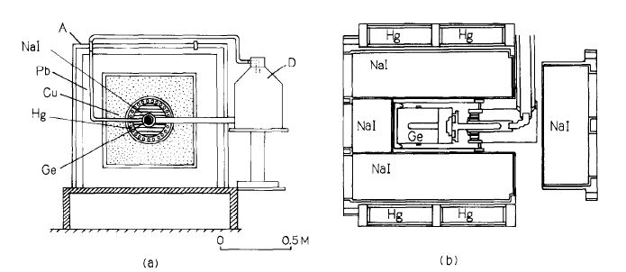
ELEGANT-III (171cc Ge + 4π anti-Compton NaI(Tl))
N. Kamikubota et al., NIM A245, 379 (1986)
Air-tight Box
NaI
Liq.N₂
Pb
OFHC
Hg
HPGe
(Cross-sectional view) (Central part)

Slide 15
LUNA @Gran Sasso (3800 m w.e.)
Beam
10⁻³~10⁻⁴ /keV/hr @2.5MeV
HPGe (137%)
--- comparable to ELEGANT-III

Slide 16
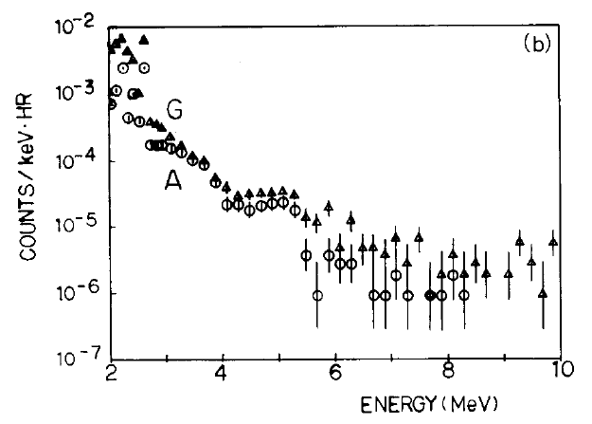
²⁰⁸Pb 3⁻→0⁺ 2.615MeV is the γ-ray
with highest energy from natural RIs.
Above 2.7MeV ;
Osaka
Kamioka
Φ_{μ} (Kamioka) ~10⁻⁵ × Φ_{μ} (Osaka)
BG(Kamioka) ~10⁻¹ ×BG(Osaka)
- - - ~10% of BG(Osaka) is not due to cosmic rays
but due to α, β+γ or neutrons from U, Th ?

Slide 17
3. How low can BG on the Earth’s surface be?
Short-baseline ν-osc. experiments; sterile?
Experiments | Neutrino source | Signal | Significance
LSND | μ Decay-At-Rest | ν_{μ} → ν_{e} | 3.8σ
MiniBooNE | π Decay-In-Flight | ν_{μ} → ν_{e} | 3.4σ
 |  | ν_{μ} → ν_{e} | 2.8σ
 |  | Combined | 3.8σ
Ga (calibration) | e capture | ν_{e} → ν_{x} | 2.7σ
Reactors | Beta decay | ν_{e} → ν_{x} | 3.0σ

Slide 18
M. Harada et al, arXiv:1310.1437 [physics.ins-det]
JSNS²
J-PARC Sterile Neutrino Search using νs
from J-PARC Spallation Neutron Source (E56)

Slide 19
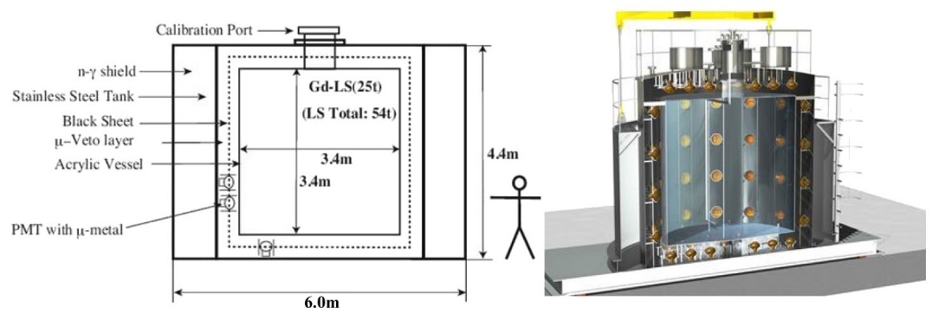
Detector
Gd-loaded Liq. Scintillator or water Cherenkov, 25ton × 2,
detecting
t_{e}=1~10μs, E_{e}=20~60MeV
t_{γ}=1~100μs, E_{γ}=6~12MeV
(253000b@thermal)
→ Delayed coincidence

Slide 20
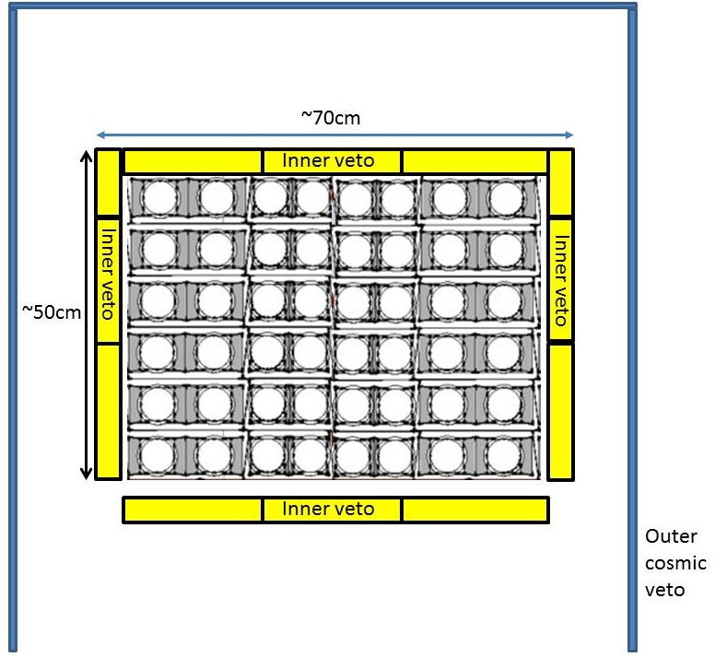
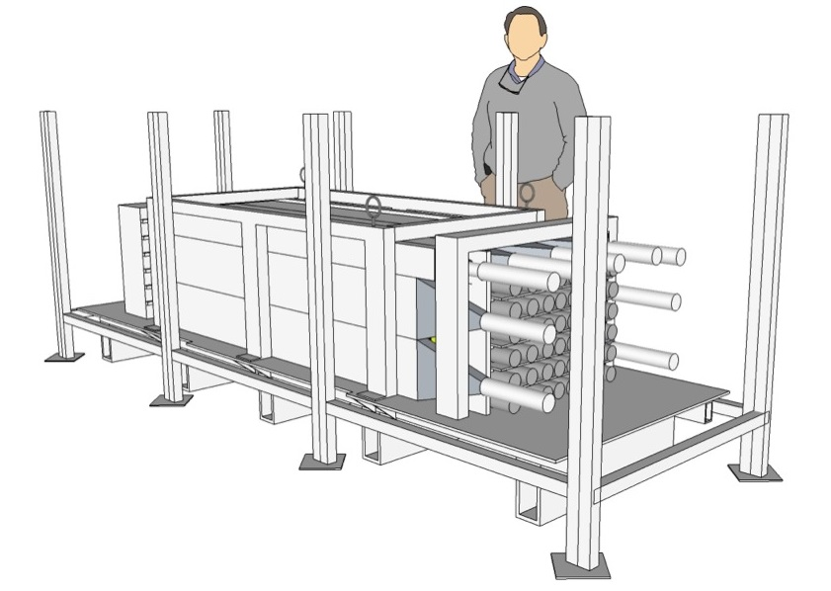
500kg detector for BG study
Main scintillators; (provided by
RCNP/LEPS2)
  24 scintillators in total. (~500kg)
  4 scintillators / layer and 6 layers
  2 Narrower (central part)
  2 Wider (in edge sides)
  Each scintillator has 4 PMTs, and 2 PMTs / one side
Inner cosmic veto (yellow)
  4.3cm thick PL scintillators
  One side readout.
  Rejection Efficiency >~99.5%
Outer cosmic veto (blue)
  PLs are used to surround main part.
  Size; 1m x 1m or 1m x 2.3m,
  1cm (t)
~1.5m
>99.8% (total)
~3.5m
~1.0m

Slide 21
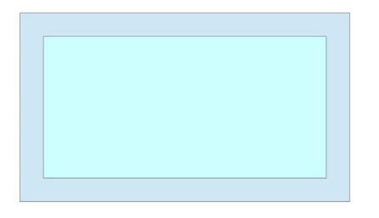
Beam-related background
μ
Prompt e
Fast neutron
π
¹⁵⁷Gd+n
Delayed γ
No difference between
the prompt spectrum
(t_{p}=1.75~4.65μs)
and the delayed spectrum
(t_{d} =t_{p} +20ms).
Excess rate <2.1×10⁻⁷
[events/spill/300kW, 90%CL]
*Pulse interval of MLF is 40ms.

Slide 22
Beam-unrelated background
S. Ajimura et al., to be appeared in PTEP, doi; 10.1093/ptep/ptv078
Cosmic neutron or γ
Capture-γ from
spallation target
★ Beam neutron is negligible because
of no difference between prompt
and delayed signal rates.

Slide 23
PICO-LONのための超高純度NaI開発
NaI(Tl)結晶の純度(単位 μBq/kg)
結晶の純度はよくなった

Slide 24
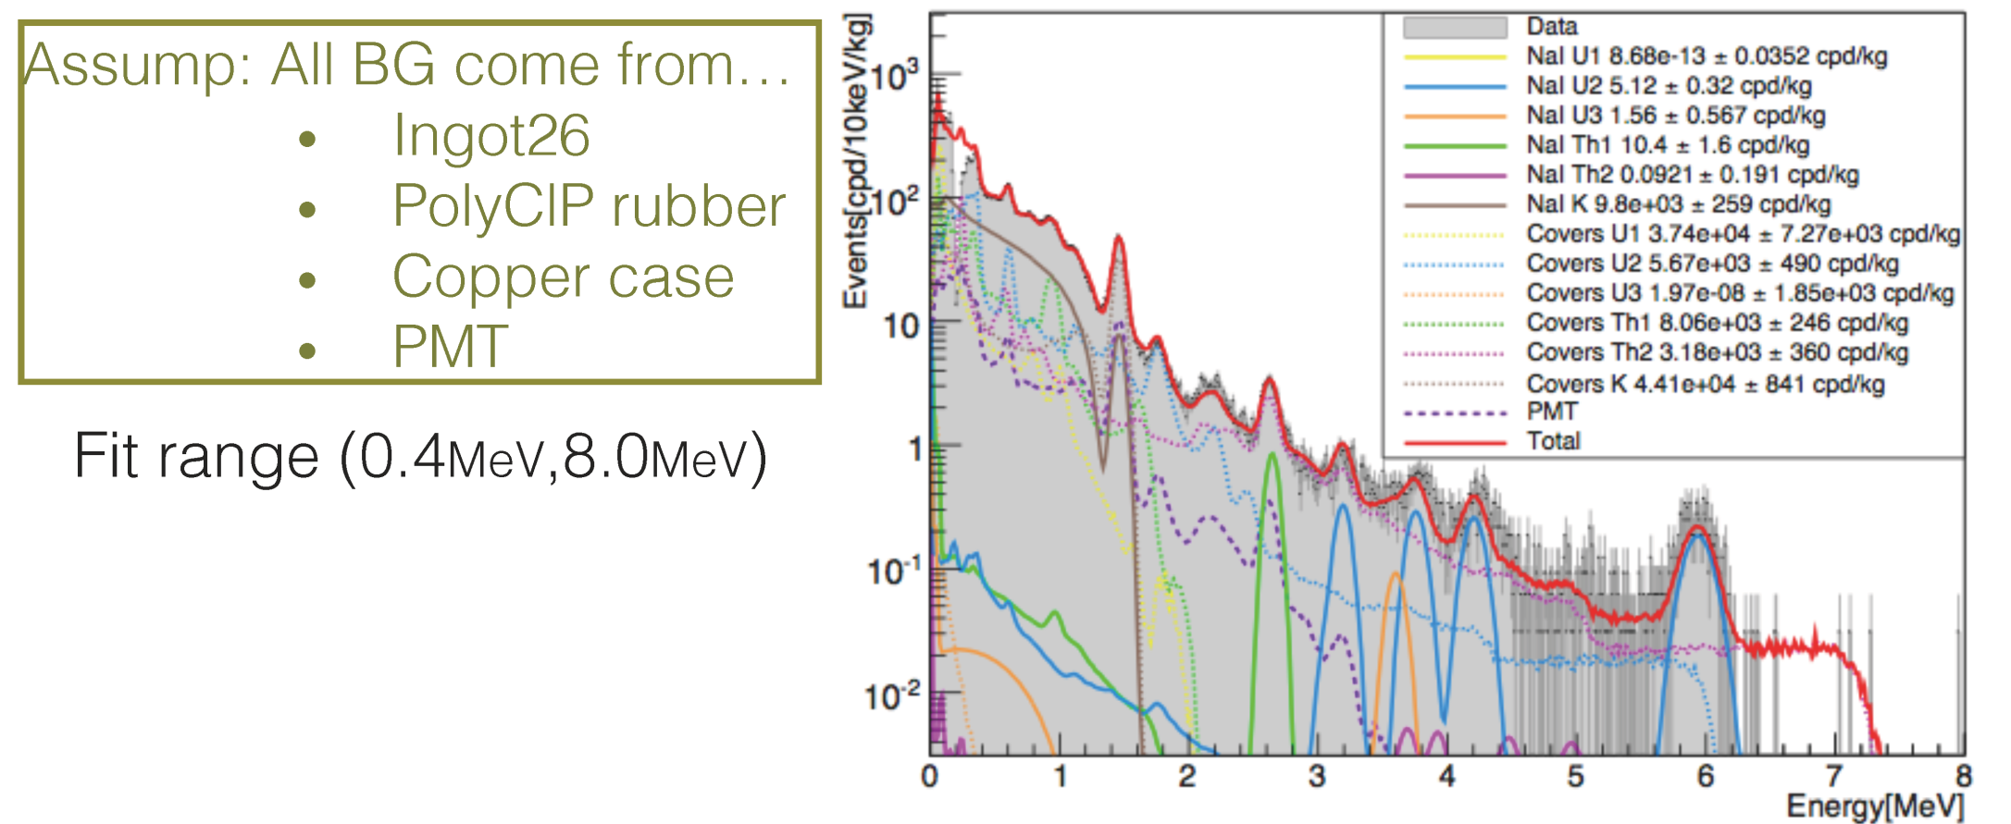
全体のバックグラウンド
（神岡地下で測定）
目標の20～30倍
殆どはNaI(Tl)周辺の素材に起因
Takemoto, Kozlov, Ikada, Teraoka

Slide 25
NaI(Tl)結晶の仕様
  直径 ５インチ(127.0 mm)
  高さ ５インチ(127.0 mm)
PMTの仕様
  直径 ４インチ(102 mm)
NaI(Tl)
SiO2 Light Guide

Slide 26
4. Summary
Low-BG detectors on the ground are useful for
accelerator experiments as well as non-acc.
experiments.
* K X-rays of muonic U, Th ~6MeV
BG in higher energy region will be due to
cosmic-ray induced γ, n
α, β+γ, n from U, Th
- - - Are they reduced with additional shielding ?
Neutron generation by μ-capture in Pb ?
Further purifications should be effective...

