Slide 1
Properties of pre-supernova neutrino in collapsing phase ～towards comprehensive neutrino studies
Waseda univ. Yamada lab.
D1 Chinami Kato
Collaboration with S. Yamada(Waseda), H. Nagakura (Caltech), W. Iwakami(Kyoto),
K. Takahashi (UT), T. Yoshida (UT), H. Umeda (UT), K. Ishidoshiro (Tohoku)

Slide 2
Outline
☑ Introduction
☑ Purpose
☑ Methods
☑ Results
☑ Summary & Future work

Slide 3
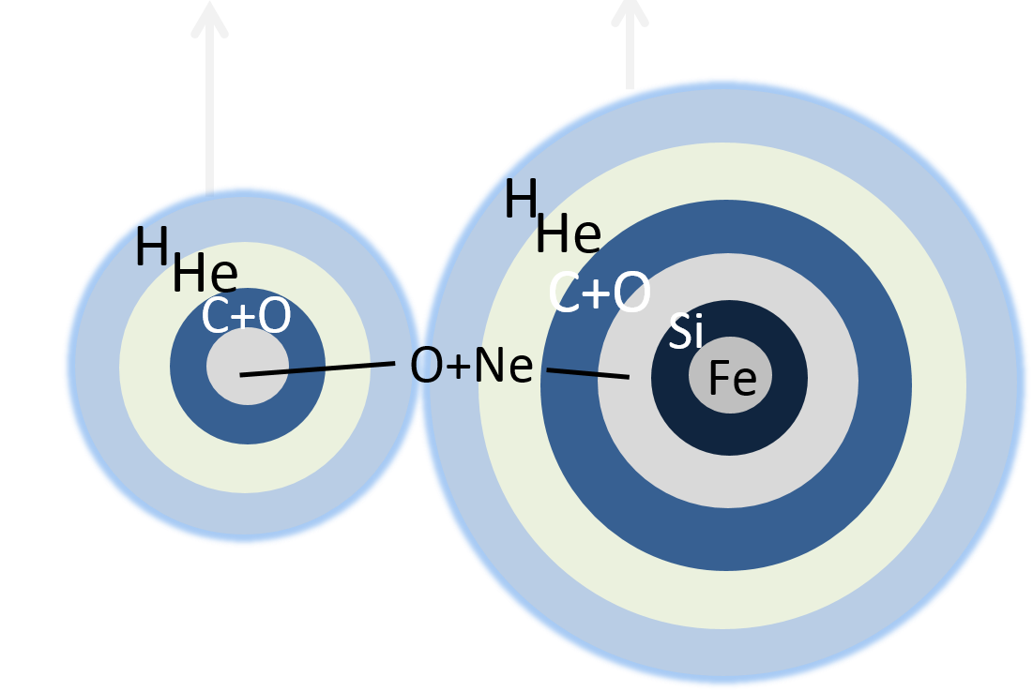
Introduction～Massive Star Evolution & Neutrino
7
1s
２０s
～10 yr
Stellar evolution
Core
collapse
Supernova
PNS
cooling
The trigger of core collapse is EC
Neutrino cooling decides core evolution
ONe core collapse
Fe core collapse
ν
γ

Slide 4
Introduction～Massive Star Evolution & Neutrino
7
1s
２０s
～10 yr
Stellar evolution
Core
collapse
Supernova
PNS
cooling
Neutrinos give energy to stalled shock
Neutrinos cool
PNS towards NS
Matter accretion
Stalled shock
ＰＮＳ

Slide 5
Introduction～Massive Star Evolution & Neutrino
1s
Neutronization burst
２０s
7
～10 yr
Stellar evolution
Core
collapse
Supernova
PNS
cooling
Pre-SN neutrino
SN neutrino
✓ structure of SN progenitor
・progenitor type
・convection property
・nuclear burning process etc.
✓ observational alert for SN
✓ mechanism of SN explosion
✓ nucleosynthesis of heavy nuclei
✓ EOS
✓ BH formation etc.

Slide 6
Purpose of our whole research
✓Detailed research about neutrino emission of each phase
✓Great progress of technique of neutrino observation
Continuous neutrino spectrum & luminosity calculation of whole massive star evolutions
Stellar evolution
Core
collapse
Supernova
PNS
cooling
Pre-SN neutrino
SN neutrino
present research

Slide 7
Purpose of present research
Neutron Star
Black Hole
Brown Dwarf
White Dwarf
Electron
Capture SN
Fe Core
Collapse SN
M>Mup
8M☉< M < Mup
H
ＳＡＧＢ
He
C+O
ＡＧＢ
H
Si
ＲＧ
He
H
C+O
Fe
H
He
H
C+O
O+Ne
He

Slide 8
METHODS
Step.1 Back ground calculation
15M
Collapsing phase
C. Kato et al.
12M
ECSN:8.4M
H.Nagakura(Caltech)
W.Iwakami
Stellar evolution phase
K. Takahashi et al.
Step.2 neutrino spectrum & luminosity
density
temperature
Ye
νe distribution
luminosity & spectrum
Post process
Pair neutrino process
Fermi Block

Slide 9
Results neutrino luminosity
Stellar evolution phase
Core Collapse phase
Short duration
ν
e
15M
12M
Constant luminosity
Log Neutrino luminosity [erg/s]
ECSN:8.4M
FeCC-SN>ECSN×100
Drastic increase

Slide 10
Results neutrino luminosity
energy loss rate [erg/s/cm]
High degeneracy
Low temperature
15M☉
Dominant neutrino emission point
T：0.7[MeV], ρ:10^9[g/cc]

Slide 11
RESULTS normalized spectrum
Kato et al.(2015)
Stellar evolution phase
time
LS
SK
ECSN:～5MeV FeCC-SN:～2MeV
Number/s/total number

Slide 12
RESULTS normalized spectrum
Core Collapse phase
Number/s/total number
12M
15M
✓ Eave:～2MeV ⇒ no time evolution

Slide 13
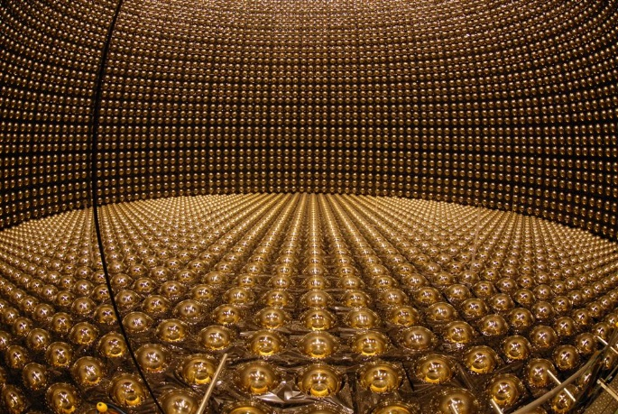
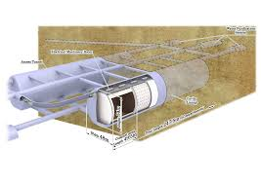
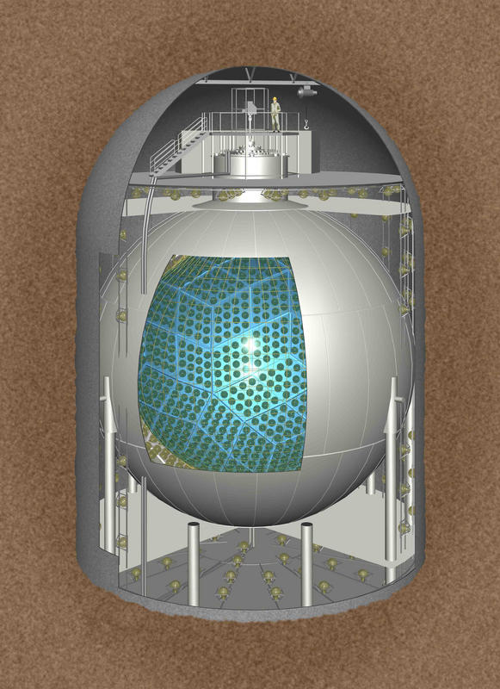
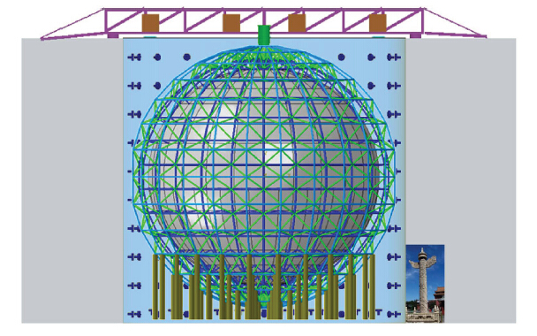
Results number of events
Water Cherenkov
SK
HK
Liquid scintillator
KamLAND

Slide 14
Results number of events
Inverse-β decay
✓event rate [s-1]
✓Neutrino oscillation
・adiabatic oscillation
・3 flavor mixing
ν
n
e
p
+
e
R=200pc
 | survival probability
normal | 0.675
inverted | 0.024
 | SK | HK | KamLAND | JUNO
threshold (MeV) | 5.3 | 8.3 | 1.8 | 1.8
target number N | 2.1×${10}^{33}$ | 3.6×${10}^{34}$ | 8.5×${10}^{31}$ | 1.7×${10}^{33}$

Slide 15
Stellar evolution phase
Core Collapse phase
15M
12M

Slide 16
Results number of events
detector | 8.4M |  | 12M |  | 15M
 | Normal | Inverted | Normal | Inverted | Normal | inverted
SK | 0.025 | 0.010 | 25 | 8.9 | 62 | 22
KamLAND | 0.0011 | 0.002 | 30 | 9 | 43 | 13
HK | 0.30 | 0.13 | 30 | 11 | 81 | 31
JUNO | 0.021 | 0.008 | 600 | 187 | 866 | 267
Detectable → FeCC-SN
Non-detactable → EC-SN
✓Betelgeuse of Orion（200pc）
✓Antares of Scorpion（150pc）
✓ε star of Pegasus（210pc)
etc….. 6 candidates
At JUNO we can detect neutrinos away from 1[kpc]!
No Background effects

Slide 17
Summary & Future work
☑ We focus on the 2 different types SN progenitors.
☑ At first, we calculate the background hydrodynamic values
☑ By post-process calculation, we get continuous neutrino luminosity about pair process from stellar evolution phase until core bounce.
☑ We can distinguish 2 types of progenitors by pre-SN neutrinos
☑ neutrino emission via weak interaction by heavy nucleus for progenitors
☑ calculate neutrino luminosities & spectrum about many progenitor initial masses

Slide 18
Stellar evolution
Core
collapse
Supernova
PNS
cooling
present research
now going…
Thank you for listening !

